Slide 1
Tic Tac Toe
COAL PROJECT
SIR HURRAR HASSAN RIZVI
SIR SAQIB SADIQ
Notes:
Alisha

Slide 2
MEMBERS
ALISHA ANWAR
HIRA NIAZ MALIK
AREEBA ZULFIQAR
AIEMEN NISAR
LAIBA JABBAR
YASEEN AHMED

Slide 3
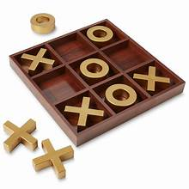
Description:
The Tic-Tac-Toe game is a classic two-player game where each player takes turns marking a cell on a 3x3 grid. The player who succeeds in placing three of their marks (either "X" or "O") in a horizontal, vertical, or diagonal row wins the game. The implementation is in Assembly language (8086), providing a low-level view of game development.

Slide 4

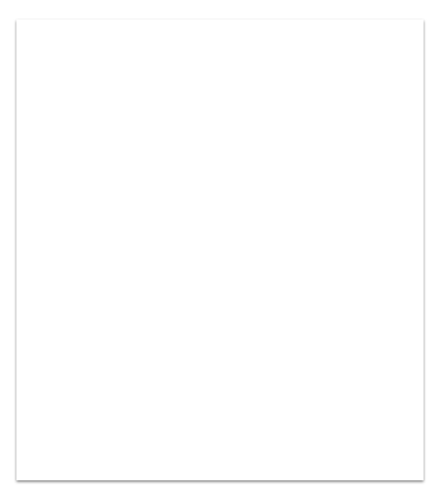
CONCEPTS IMPLEMENTED
Assembly (8086)
Text-Based Interface
Game Logic
User Input Handling:
Graphics (ASCII Art)
Notes:
Yaseen

Slide 5
FEATURES
Title Screen
Game Rules
Board Display
Player Interaction:
Winning Condition
Draw Condition
Play Again Option
Console Interface
Player vs. Player:
Winning Conditions

Slide 6
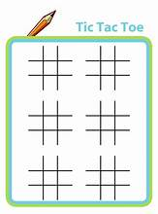
PRINT MACRO P1
LEA DX,P1 ;PRINT
MOV AH,9
INT 21H
ENDM
INPUT MACRO
MOV AH, 7 ; INPUT WITHOUT ECHO
INT 21H
ENDM
INECHO MACRO
MOV AH, 1 ;INPUT WITH ECHO
INT 21H
ENDM
MACROS .
Notes:
Aimen

Slide 7
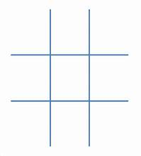
DATA
; LINES USED TO BUILD THE TIC - TAC - TOE LOGO
; GAME RULES
; CELL MARK FOR PLAYERS
; BOARD LINES
; CELL NUMBERS
; INPUT SECTION PROMPTS
; CURRENT MARK (X/O)
; TRY AGAIN PROMPT MESSAGES

Slide 8
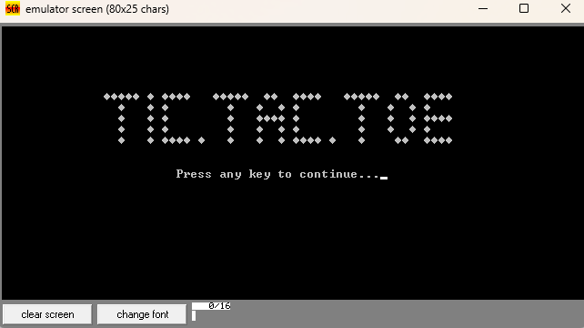
MAIN SCREEN
Notes:
Areeba

Slide 9
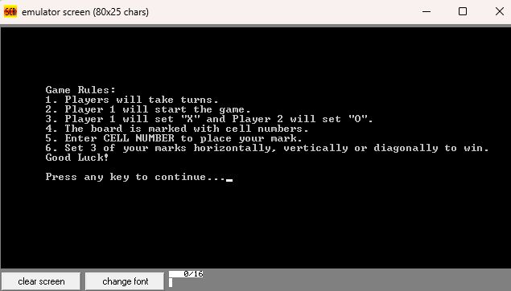
RULES
Notes:
Areeba

Slide 10

CODE
LOGO DISPLAY START
DISPLAY GAME RULES

Slide 11
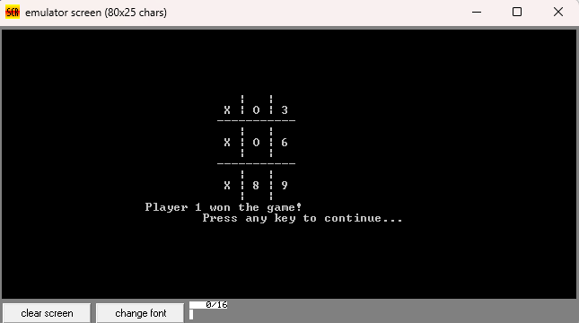
Board
Notes:
Laiba

Slide 12
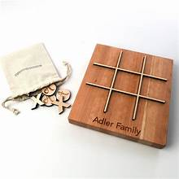
CODE
INITIALIZE
BOARD
INPUT

Slide 13
WIN
Notes:
HIRA

Slide 14
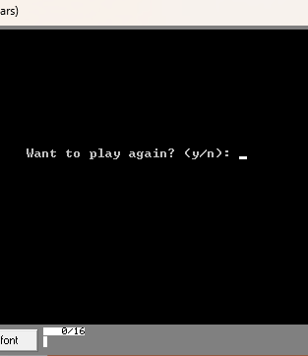
CODE
VICTORY
DRAW
CHECK IF WINNING CONDITION IS MET
TRY AGAIN

Slide 15
Milestones
WORKING ON LOGIC
COMBINING AND UNDERSTANDING
END OF NOVEMBER |  |  |  | DECEMBER
DIVIDING AND WORKING ON CODE
DOCUMENTATION AND PPT

Slide 16
Conclusion
In conclusion, this Assembly (8086) implementation of Tic-Tac-Toe demonstrates the utilization of low-level programming to create a text-based interactive game. The project successfully integrates game logic, user input handling, and ASCII art to provide a classic gaming experience. Enhancements and optimizations can be explored for future iterations, but the current implementation serves as a foundation for understanding Assembly language programming and game development.

Slide 17
THANK YOU

